Slide 1

Noida Institute of Engineering and Technology, Greater Noida
Overview of Natural Language Processing
Unit: 1
Natural Language Processing
Subject Code: ACSAI0712
Mr. M. Abdul Mateen Siddiqui
(Assistant Professor)
Department of CSE (Cyber Security)
Course Details B. Tech. VII Sem

Slide 2
Faculty Introduction
Name : Mr. M. Abdul Mateen Siddiqui
Qualification: B. Tech (CSE), M. Tech (CSE-CFIS), Ph. D (Pursuing)
Area of Specialization: Cyber Forensics, Information Security, Digital Forensics, Smart Wearable Devices and IoT Devices

Slide 3
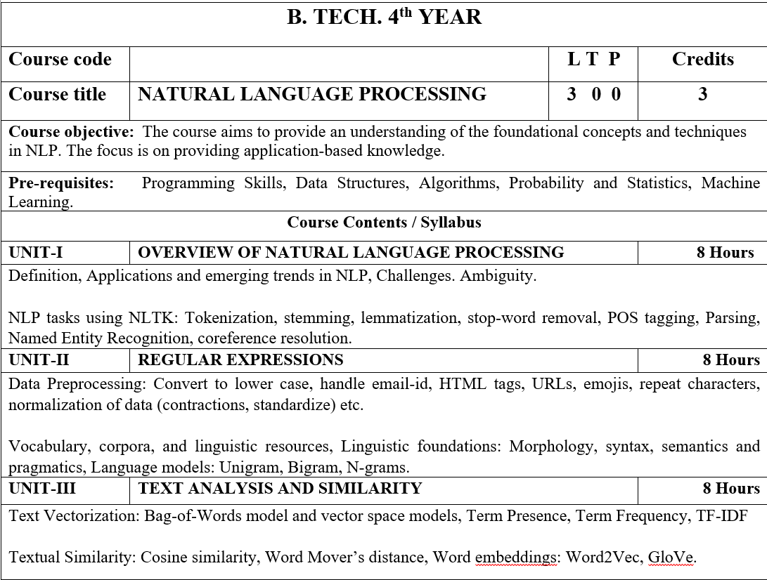
Syllabus

Slide 4
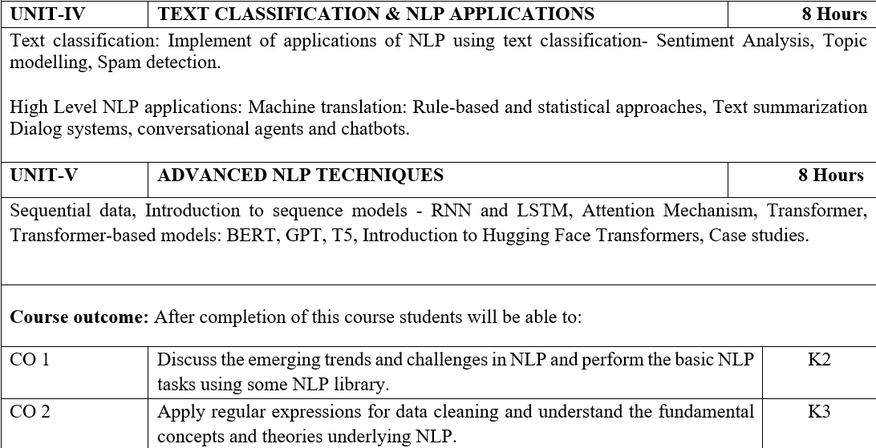
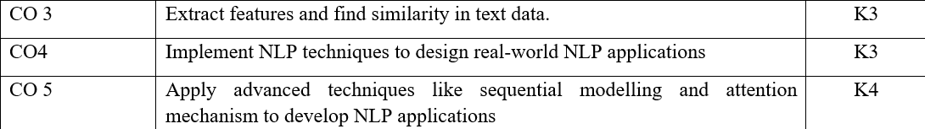
Syllabus

Slide 5
Video Links
https://realpython.com/nltk-nlp-python/
https://www.coursera.org/lecture/python-text-mining/basic-nlp-tasks-with-nltk-KD8uN
https://www.coursera.org/lecture/nlp-sequence-models/learning-word-embeddings-APM5s
https://www.coursera.org/projects/regular-expressions-in-python
https://www.coursera.org/learn/python-text-mining/lecture/sVe8B/regular-expressions

Slide 6
Course Objective
The course aims to provide an understanding of the foundational concepts and techniques in NLP.
The focus is on providing application-based knowledge.

Slide 7
Course Outcome
CO1 | Discuss the emerging trends and challenges in NLP and perform the basic NLP tasks using some NLP library. | K2
CO2 | Apply regular expressions for data cleaning and understand the fundamental concepts and theories underlying NLP. | K3
CO3 | Extract features and find similarity in text data. | K3
CO4 | Implement NLP techniques to design real-world NLP applications | K3
CO5 | Apply advanced techniques like sequential modelling and attention mechanism to develop NLP applications | K4

Slide 8
Program Outcome
1. Engineering knowledge: Apply the knowledge of mathematics, science, engineering fundamentals, and an engineering specialization for the solution of complex engineering problems.
2. Problem analysis: Identify, formulate, research literature, and analyze complex engineering problems reaching substantiated conclusions using first principles of mathematics, natural sciences, and engineering sciences.
3. Design/development of solutions: Design solutions for complex engineering problems and design system components or processes that meet the specified needs with appropriate consideration for public health and safety, and cultural, societal, and environmental considerations.

Slide 9
Program Outcome
4. Conduct investigations of complex problems: Use research based knowledge and research methods including design of experiments, analysis and interpretation of data, and synthesis of information to provide valid conclusions.
5. Modern tool usage: Create, select, and apply appropriate techniques, resources, and modern engineering and IT tools, including prediction and modeling to complex engineering activities, with an understanding of the limitations.
6. The engineer and society: Apply reasoning informed by the contextual knowledge to assess societal, health, safety, legal and cultural issues and the consequent responsibilities relevant to the professional engineering practice.

Slide 10
Program Outcome
7. Environment and sustainability: Understand the impact of the professional engineering solutions in societal and environmental contexts, and demonstrate the knowledge of, and need for sustainable development.
8. Ethics: Apply ethical principles and commit to professional ethics and responsibilities and norms of the engineering practice.
9. Individual and team work: Function effectively as an individual, and as a member or leader in diverse teams, and in multidisciplinary settings.

Slide 11
Program Outcome
10. Communication: Communicate effectively on complex engineering activities with the engineering community and with the society at large, such as, being able to comprehend and write effective reports and design documentation, make effective presentations, and give and receive clear instructions.
11. Project management and finance: Demonstrate knowledge and understanding of the engineering and management principles and apply these to one’s own work, as a member and leader in a team, to manage projects and in multidisciplinary environments.
12.Life-long learning: Recognize the need for, and have the preparation and ability to engage in independent and life-long learning in the broadest context of technological change.

Slide 12
Pre-requisites
Programming Skills,
Data Structures,
Algorithms,
Probability and Statistics,
Machine Learning.

Slide 13
Unit-1:Content
OVERVIEW OF NATURAL LANGUAGE PROCESSING:
Definition of NLP
Applications and emerging trends in NLP
NLP tasks using NLTK:
Tokenization,
Stemming,
Lemmatization,
Stop-word removal,
Parsing,
Named Entity Recognition.

Slide 14
What is NLP?
NLP stands for Natural Language Processing, which is a part of Computer Science, Human language, and Artificial Intelligence.
It is the technology that is used by machines to understand, analyze, manipulate, and interpret human's languages.
It helps developers to organize knowledge for performing tasks such as translation, automatic summarization, Named Entity Recognition (NER), speech recognition, relationship extraction, and topic segmentation.

Slide 15
What is NLP?
AI concerned with giving computers the ability to understand text and spoken words in much the same way human beings can.
NLP drives computer programs that translate text from one language to another, respond to spoken commands —even in real time.
There’s a good chance you’ve interacted with NLP in the form of voice-operated GPS systems, digital assistants, speech-to-text dictation software, customer service chatbots, and other consumer conveniences.

Slide 16
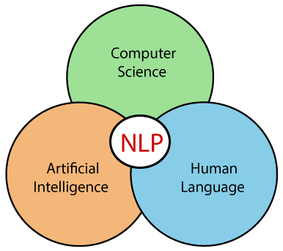
What is NLP?

Slide 17

What is NLP?
Natural Language Processing (NLP) refers to AI method of communicating with an intelligent systems using a natural language such as English.
Processing of Natural Language is required when you want an intelligent system like robot to perform as per your instructions, when you want to hear decision from a dialogue based clinical expert system, etc.
The field of NLP involves making computers to perform useful tasks with the natural languages humans use.
The input and output of an NLP system can be:
Speech
Written Text

Slide 18
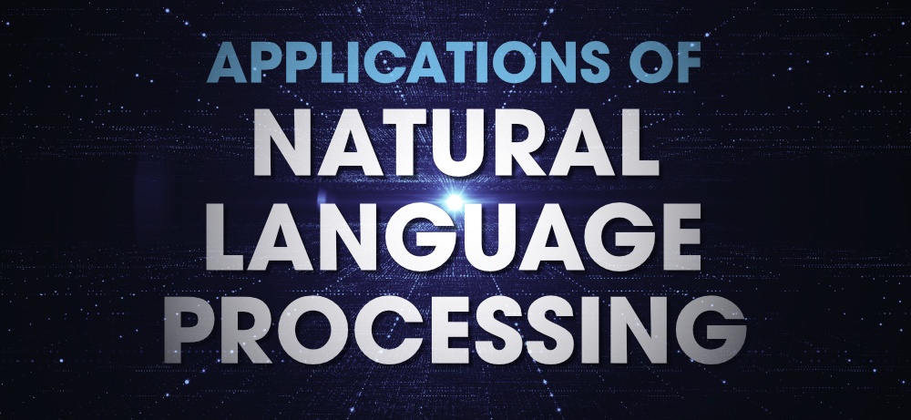
Applications of NLP

Slide 19
Applications of NLP
Applications of Natural Language Processing:
Chatbots
Autocomplete in Search Engines
Voice Assistants
Language Translator
Sentiment Analysis
Grammar Checkers
Email Classification and Filtering

Slide 20
Chatbots
Chatbots are a form of artificial intelligence that are programmed to interact with humans in such a way that they sound like humans themselves.
Depending on the complexity of the chatbots, they can either just respond to specific keywords or they can even hold full conversations that make it tough to distinguish them from humans.
Chatbots are created using Natural Language Processing and Machine Learning, which means that they understand the complexities of the English language and find the actual meaning of the sentence and they also learn from their conversations with humans and become better with time.
Chatbots work in two simple steps. First, they identify the meaning of the question asked and collect all the data from the user that may be required to answer the question. Then they answer the question appropriately.

Slide 21
Autocomplete in Search Engines
Have you noticed that search engines tend to guess what you are typing and automatically complete your sentences? For example, On typing “game” in Google, you may get further suggestions for “game of thrones”, “game of life” or if you are interested in maths then “game theory”.
All these suggestions are provided using autocomplete that uses Natural Language Processing to guess what you want to ask.
Search engines use their enormous data sets to analyze what their customers are probably typing when they enter particular words and suggest the most common possibilities.
They use Natural Language Processing to make sense of these words and how they are interconnected to form different sentences.

Slide 22
These days voice assistants are all the rage! Whether its Siri, Alexa, or Google Assistant, almost everyone uses one of these to make calls, place reminders, schedule meetings, set alarms, surf the internet, etc.
These voice assistants have made life much easier.
But how do they work? They use a complex combination of speech recognition, natural language understanding, and natural language processing to understand what humans are saying and then act on it.
The long term goal of voice assistants is to become a bridge between humans and the internet and provide all manner of services based on just voice interaction.
However, they are still a little far from that goal seeing as Siri still can’t understand what you are saying sometimes!
Voice Assistants

Slide 23
Want to translate a text from English to Hindi but don’t know Hindi? Well, Google Translate is the tool for you! While it’s not exactly 100% accurate, it is still a great tool to convert text from one language to another.
Google Translate and other translation tools as well as use Sequence to sequence modeling that is a technique in Natural Language Processing.
It allows the algorithm to convert a sequence of words from one language to another which is translation.
Earlier, language translators used Statistical machine translation (SMT) which meant they analyzed millions of documents that were already translated from one language to another (English to Hindi in this case) and then looked for the common patterns and basic vocabulary of the language.
However, this method was not that accurate as compared to Sequence to sequence modeling.
Language Translator

Slide 24
Almost all the world is on social media these days! And companies can use sentiment analysis to understand how a particular type of user feels about a particular topic, product, etc.
They can use natural language processing, computational linguistics, text analysis, etc. to understand the general sentiment of the users for their products and services and find out if the sentiment is good, bad, or neutral.
Companies can use sentiment analysis in a lot of ways such as to find out the emotions of their target audience, to understand product reviews, to gauge their brand sentiment, etc.
And not just private companies, even governments use sentiment analysis to find popular opinion and also catch out any threats to the security of the nation.
Sentiment Analysis

Slide 25
Grammar and spelling is a very important factor while writing professional reports for your superiors even assignments for your lecturers.
After all, having major errors may get you fired or failed! That’s why grammar and spell checkers are a very important tool for any professional writer.
They can not only correct grammar and check spellings but also suggest better synonyms and improve the overall readability of your content.
And guess what, they utilize natural language processing to provide the best possible piece of writing! The NLP algorithm is trained on millions of sentences to understand the correct format.
That is why it can suggest the correct verb tense, a better synonym, or a clearer sentence structure than what you have written.
Some of the most popular grammar checkers that use NLP include Grammarly etc.
Grammar Checkers

Slide 26
Emails are still the most important method for professional communication.
However, all of us still get thousands of promotional Emails that we don’t want to read.
Thankfully, our emails are automatically divided into 3 sections namely, Primary, Social, and Promotions which means we never have to open the Promotional section! But how does this work? Email services use natural language processing to identify the contents of each Email with text classification so that it can be put in the correct section.
This method is not perfect since there are still some Promotional newsletters in Primary, but its better than nothing.
In more advanced cases, some companies also use specialty anti-virus software with natural language processing to scan the Emails and see if there are any patterns and phrases that may indicate a phishing attempt on the employees.
Email Classification and Filtering

Slide 27
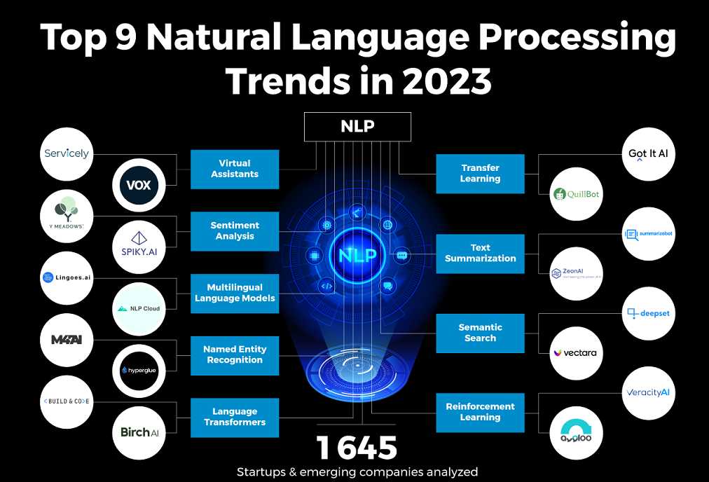
Emerging Trends in NLP

Slide 28
There is a growing interest in virtual assistants in devices and applications as they improve accessibility and provide information on demand.
However, they deliver accurate information only if the virtual assistants understand the query without misinterpretation.
That is why startups are leveraging NLP to develop novel virtual assistants and chatbots.
They mitigate processing errors and work continuously, unlike human virtual assistants.
Virtual Assistants

Slide 29
Our increasingly digital world generates exponential amounts of data as audio, video, and text.
While natural language processors are able to analyze large sources of data, they are unable to differentiate between positive, negative, or neutral speech.
Moreover, when support agents interact with customers, they are able to adapt their conversation based on the customers’ emotional state which typical NLP models neglect.
Therefore, startups are creating NLP models that understand the emotional or sentimental aspect of text data along with its context.
Such NLP models improve customer loyalty and retention by delivering better services and customer experiences.
Sentiment Analysis

Slide 30
Communication is highly complex, with over 7000 languages spoken across the world, each with its own intricacies.
Most current natural language processors focus on the English language and therefore either do not cater to the other markets or are inefficient.
The availability of large training datasets in different languages enables the development of NLP models that accurately understand unstructured data in different languages.
This improves data accessibility and allows businesses to speed up their translation workflows and increase their brand reach.
Multilingual Language Models

Slide 31
Data classification and annotation are important for a wide range of applications such as autonomous vehicles, recommendation systems, and more.
However, classifying data from unstructured data proves difficult for nearly all traditional processing algorithms.
Named entity recognition (NER) is a language processor that removes these limitations by scanning unstructured data to locate and classify various parameters.
Besides identifying person names, organizations, brands, etc.
NER classifies dates and times, email addresses, and numerical measurements like money and weight.
NER models thus facilitate data extraction workflows across industries.
Named Entity Recognition

Slide 32
Natural language solutions require massive language datasets to train processors.
This training process deals with issues, like similar-sounding words, that affect the performance of NLP models.
Language transformers avoid these by applying self-attention mechanisms to better understand the relationships between sequential elements.
Moreover, this type of neural network architecture ensures that the weighted average calculation for each word is unique.
Language Transformers

Slide 33
Machine learning tasks are domain-specific and models are unable to generalize their learning.
This causes problems as real-world data is mostly unstructured, unlike training datasets.
Consequently, this affects the predictability of the trained models.
However, many language models are able to share much of their training data using transfer learning to optimize the general process of deep learning.
The application of transfer learning in natural language processing significantly reduces the time and cost to train new NLP models.
Transfer Learning

Slide 34
Natural language processors are extremely efficient at analyzing large datasets to understand human language as it is spoken and written.
However, typical NLP models lack the ability to differentiate between useful and useless information when analyzing large text documents.
Therefore, startups are applying machine learning algorithms to develop NLP models that summarize lengthy texts into a cohesive and fluent summary that contains all key points.
The main benefits of such language processors are the time savings in deconstructing a document and the increase in productivity from quick data summarization.
Text Summarization

Slide 35
Search engines are an integral part of workflows to find and receive digital information.
One of the barriers to effective searches is the lack of understanding of the context and intent of the input data.
NLP enables semantic search queries that analyze search intent.
This improves search accuracy and provides more relevant results.
Hence, semantic search models find applications in areas such as eCommerce, academic research, enterprise knowledge management, and more.
Semantic Search

Slide 36
Currently, NLP-based solutions struggle when dealing with situations outside of their boundaries.
Therefore, AI models need to be retrained for each specific situation that it is unable to solve, which is highly time-consuming.
Reinforcement learning enables NLP models to learn behavior that maximizes the possibility of a positive outcome through feedback from the environment.
This enables developers and businesses to continuously improve their NLP models’ performance through sequences of reward-based training iterations.
Such learning models thus improve NLP-based applications such as healthcare and translation software, chatbots, and more.
Reinforcement Learning

Slide 37


Slide 38


Major Challenges of using NLP
Major Challenges of using Natural Language Processing:
Multiple intents in one question
Assuming it understands context and has memory
Misspellings in entity extraction
Same word - different meaning
Keeping the conversation going
Tackling false positives

Slide 39
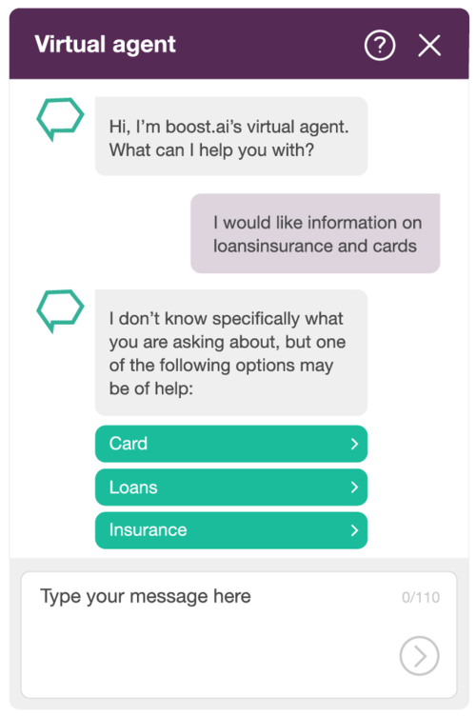
Multiple intents in one question
When a customer asks for several things at the same time, such as different products, Virtual Agent conversational AI can easily distinguish between the multiple variables.
Here - in this example to showcase our technology’s ability - the AI is able to not only split the misspelled word “loansinsurance”, but also correctly identify the three key topics of the customer's input.
It then automatically proceeds with presenting the customer with three distinct options, which will continue the natural flow of the conversation, as opposed to overwhelming the limited internal logic of a chatbot.

Slide 40
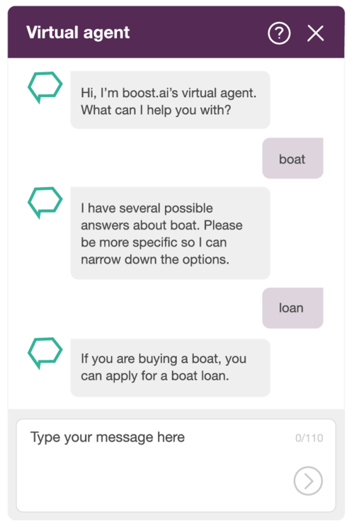
Assuming it understands context and has memory
In the event that a customer does not provide enough details in their initial query, the conversational AI is able to extrapolate from the request and probe for more information.
The new information it then gains, combined with the original query, will then be used to provide a more complete answer.
First, it understands that “boat” is something the customer wants to know more about, but it’s too vague.
It asks for more details so it can narrow it down. Even though the second response is very limited, it’s still able to remember the previous input and understands that the customer is probably interested in purchasing a boat and provides relevant information on boat loans.

Slide 41
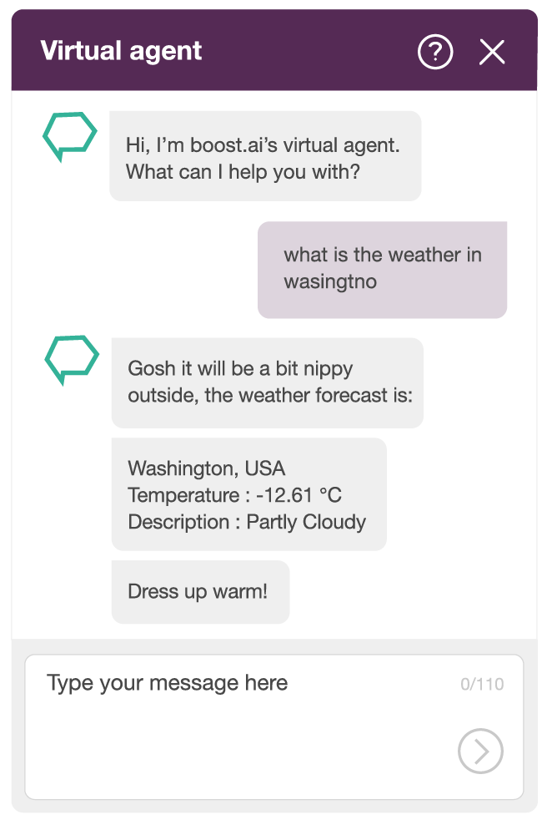
Misspellings in Entity Extraction
Spelling mistakes and typos are a natural part of interacting with a customer. Our conversational AI uses machine learning and spell correction to easily interpret misspelled messages from customers, even if their language is remarkably sub-par.
It can identify that a customer is making a request for a weather forecast, but the location (i.e. entity) is misspelled in this example. By using spell correction on the sentence, and approaching entity extraction with machine learning, it’s still able to understand the request and provide correct service.

Slide 42
Same word - Different Meaning
Expertly understanding language depends on the ability to distinguish the importance of different keywords in different sentences.
Take the following user queries, for example:
How are you?
How can I change my account?
In the first sentence, the ‘How’ is important, and the conversational AI understands that, letting the digital advisor respond correctly.
In the second example, ‘How’ has little to no value and it understands that the user’s need to make changes to their account is the essence of the question.

Slide 43

Keeping the Conversation Going
The GUI for conversational AI should give you the tools for deeper control over extract variables, and give you the ability to determine the flow of a conversation based on user input - which you can then customize to provide additional services.
Here, the virtual travel agent is able to offer the customer the option to purchase additional baggage allowance by matching their input against information it holds about their ticket.
Add-on sales and a feeling of proactive service for the customer provided in one swoop.

Slide 44
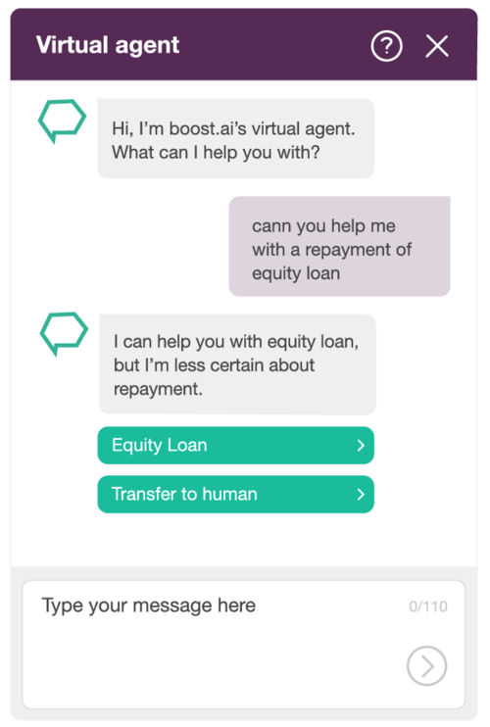
Tackling False Positives
The False positives occur when a customer requests something that it should be able to answer but has not yet learned how. Conversational AI is able to identify the relevant parts of a conversation and offer assistance based on existing knowledge while acknowledging the gaps in its ability.
In this example, the AI understands that the customer requires assistance for an equity loan and provides a relevant link.
At the same time, it understands that the user wants help with an unknown entity (repayment) and, while it is unable to assist, it correctly identifies it.

Slide 45
Ambiguity in NLP
Ambiguity in NLP refers to situations in which a particular word, phrase or sentence has multiple possible interpretations or meanings.
Ambiguity is a common characteristic of natural language, and it arises due to the richness and complexity of human language.
Here are some common types of ambiguity:
Lexical Ambiguity: Lexical ambiguity occurs when a single word has multiple meanings or senses.
Example: I can play cricket and give me that can.
Syntactic Ambiguity: Syntactic ambiguity arises when the grammatical structure of a sentence allows for multiple interpretations.
Example: Amit saw the man with binnoculars, Amit saw the man carrying binnoculars and Amit saw the man through binnoculars.
Semantic Ambiguity: Semantic ambiguity occurs when a sentence or phrase is open to different interpretations based on the meanings of the words used.
Example: Amit loves his cat and Durgesh does too.
Anaphoric Ambiguity: Anaphoric ambiguity arises when a noun replaces with a pronouns or other referring expressions lack clarity in identifying their antecedents.
Example: The house is on a long street. It is very dirty.

Slide 46
NLTK
NLTK (Natural Language Toolkit) is a Python library and platform designed for working with human language data, especially in the field of natural language processing (NLP) and computational linguistics.
It was developed by Steven Bird and Edward Loper and has become one of the most widely used libraries for NLP tasks.

Slide 47

Here are some common NLP tasks that you can perform using NLTK:
Tokenization
Stemming
Lemmatization
Stop-Word Removal
POS Tagging
Parsing
Named Entity Recognition
Coreference Resolution.

Slide 48
Tokenization
Tokenization is a fundamental text processing task in natural language processing (NLP) that involves breaking down a text or a sequence of characters into smaller units, known as tokens.
Tokens are typically words, but they can also be subword units, such as subword pieces in subword tokenization characters in character-level tokenization.
Example: Dinesh is an abnormal human.
Now, Token 1: Dinesh, Token 2: is, Token 3: an, Token 4: abnormal, Token 5: human

Slide 49
Stemming
Stemming is a text normalization technique in natural language processing (NLP) that involves reducing words to their root or base form, known as a "stem."
The purpose of stemming is to group words with similar meanings together by removing suffixes or prefixes, which can help in tasks like information retrieval, text mining, and document clustering.
Example 1: Knows, Known, Knowing and finally Know word comes.
Example 2: Date, Dated, Dating and finally Dat word comes so it is disadvantage of stemming.

Slide 50
Lemmatization
Lemmatization is a text normalization technique in natural language processing (NLP) that involves reducing words to their base or dictionary form, known as the "lemma."
Unlike stemming, which applies heuristic rules to remove word endings, lemmatization uses linguistic knowledge and a vocabulary or dictionary to transform words into their canonical forms.
Example: Die, Died, Dead and finally Die word comes.

Slide 51
Stop-Word Removal
Stop-Word Removal is a common text preprocessing technique in natural language processing (NLP) that involves removing words that are considered to be of little value or that do not contribute much to the overall meaning of a document.
These words are known as "stop words."
Stop words are typically the most frequent words in a language and often include common words like "the," "and," "in," "is," "at," and so on.

Slide 52
POS Tagging
Part-of-Speech (POS) tagging, also known as grammatical tagging or word-category disambiguation.
It is a fundamental task in natural language processing (NLP).
It involves assigning a specific grammatical category or part of speech (e.g., noun, verb, adjective) to each word in a text or a sentence.
POS tagging is crucial for understanding the structure and meaning of sentences, and it serves as a building block for many NLP applications.
Example 1: Amit killed a bat and ate it i.e. Amit = Noun, killed = Verb, a = determinant, bat = noun, and = conjunction, ate = verb, it = pronoun.
Example 2: Google it i.e. Google = Noun & Verb, it = pronoun so it is disadvantage of POS Tagging.

Slide 53
Parsing
Parsing is a crucial process in natural language processing (NLP) that involves analyzing the grammatical structure of sentences and determining the relationships between words in a given text.
Parsing aims to understand the syntactic structure of language, including how words are organized into phrases and sentences.

Slide 54
Name Entity Recognition
Named Entity Recognition (NER), also known as entity extraction or entity recognition.
It is a natural language processing (NLP) task that involves identifying and classifying named entities in text into predefined categories or types.
Named entities are words or phrases that refer to specific entities in the real world, such as people, organizations, locations, dates, and more.
NER is an essential component in various NLP applications and information retrieval systems.
Example : Google it i.e. Google is a company name so in this all names categorised into company, location and name.

Slide 55
Coreference Resolution
Coreference Resolution is a natural language processing (NLP) task that involves identifying when different words or expressions in a text refer to the same entity or concept.
In other words, it aims to resolve coreferences, which are linguistic relationships between words or phrases that refer to the same entity.
Coreference resolution is crucial for understanding the meaning of text, as it helps establish connections between different parts of a document.

Slide 56
THANK YOU

